Slide 1
Cardiopulmonary Resuscitation
Dr. S G Shyam Lakshman
SR cardiology

Slide 2
Defined as an attempt to restore spontaneous circulation after a person goes in sudden cardiac arrest(SCA).
Can also be defined as a series of lifesaving actions that improve the chance of survival following cardiac arrest
Sudden Cardiac Arrest- Defined as abrupt cessation of cardiac mechanical function, which may be reversible by a prompt intervention but will lead to death in its absence.

Slide 5
Types (forms) of cardiac arrest:
Asystole (Isoelectric line).
Ventricular fibrillation (VF).
Ventricular tachycardia (VT).
Pulseless electrical activity(PEA)

Slide 6
BASIC LIFE SUPPORT( BLS)
Circulation
Airway
Breathing

Slide 7
ADVANCED CARDIAC LIFE SUPPORT(ACLS)
Includes a variety of interventions including airway intubation, mechanical ventilation and drugs given during cardiac arrest.

Slide 8
CHAIN OF SURVIVAL
SCA continues to be a leading cause of death in many parts of the world.
SCA has many etiologies (ie, cardiac or non cardiac causes), circumstances (eg, witnessed or un witnessed), and settings (eg, out-of-hospital or in-hospital).
This heterogeneity suggests that a single approach to resuscitation is not practical, but a core set of actions provides a universal strategy for achieving successful resuscitation. These actions are termed the links in the “Chain of Survival.”

Slide 9
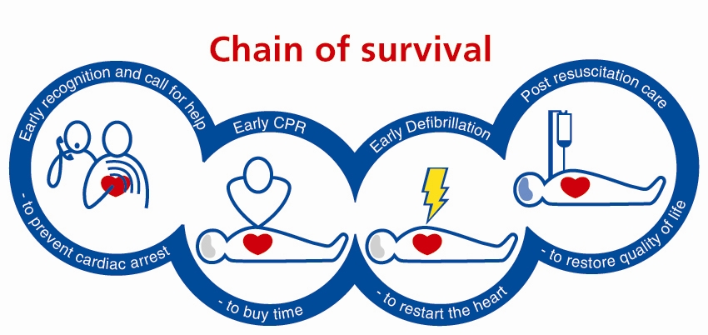
Chain of Survival
These include:-
Early recognition & call for help: to prevent cardiac arrest.
Early CPR (with minimal interruptions): to buy time.
Early defibrillation: to restart the heart.
Post resuscitation care: to restore quality of life & minimize neurological insult.

Slide 10
Sequence of steps OF CPR
Early Recognition of sudden cardiac arrest (SCA)
Unresponsiveness- gently tap the patient and check for response
Breathing-lack of breathing or abnormal breathing (gasping)
Activating Emergency Response System
Call for help
Arrange for defibrillator
Check Pulse
Central Pulse: Carotid or femoral
Pulse should be checked for not more than 10 seconds

Slide 11
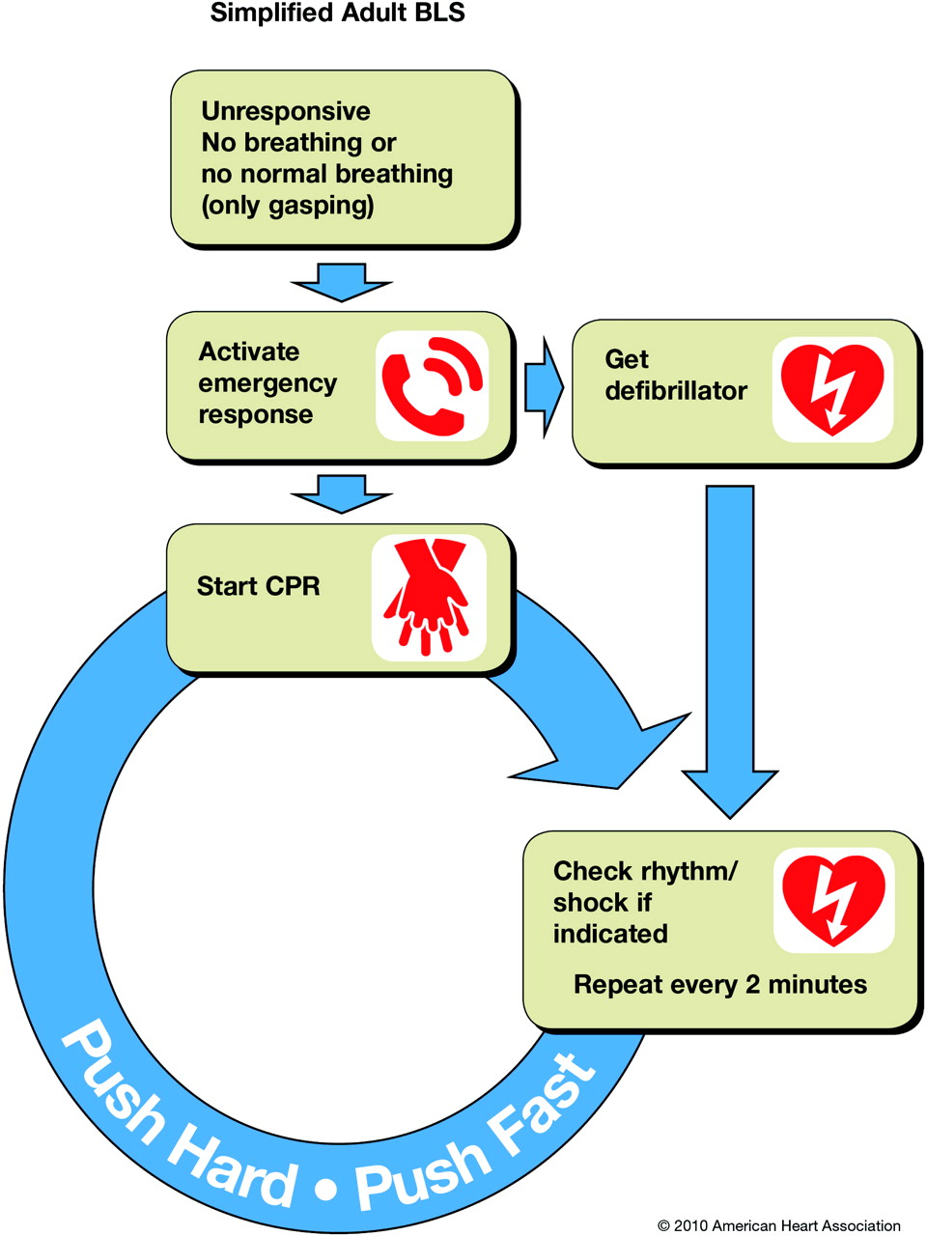
Simplified adult BLS algorithm.
Berg R A et al. Circulation. 2010;122:S685-S705
Copyright © American Heart Association, Inc. All rights reserved.
Notes:
Simplified adult BLS algorithm.

Slide 12
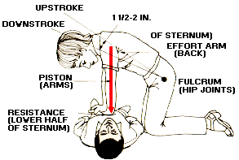
Chest compressions
Positioning:
Person should be lied on hard and flat surface.
Rescuer kneels beside victim.
During compressions arms should be kept straight, elbows locked and shoulder directly above the hand.
Heel of the dominant hand is placed on the lower half of victim’s chest, between the nipples. Heel of second hand is placed on top of the first hand so the hands are overlapped and parallel.
Fingers are interlocked.

Slide 13
On correct positioning, straight downward thrust is given on sternum depressing it 2 inches (5 cm) in adults and then allowing to return to its normal position.
Compression rate – At least 100 per minute in single or two person CPR.
Compression-Ventilation ratio of 30:2 should be maintained with minimal interruption in chest compressions for rescue breaths.
Compression-relaxation should be 50:50

Slide 14
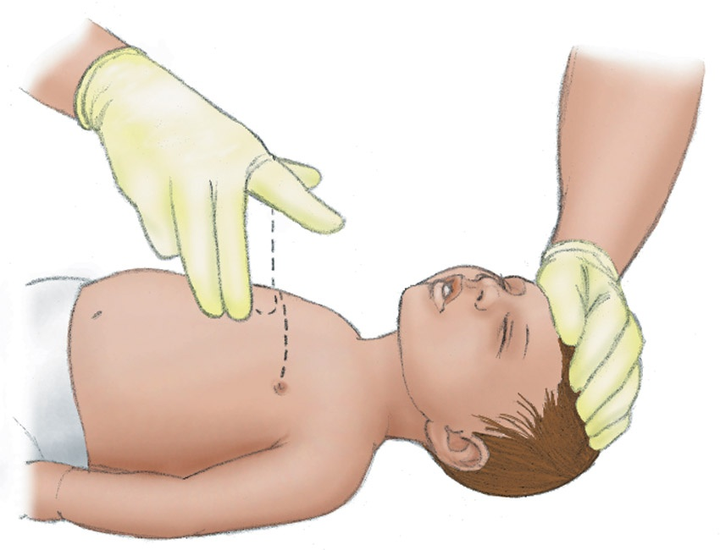
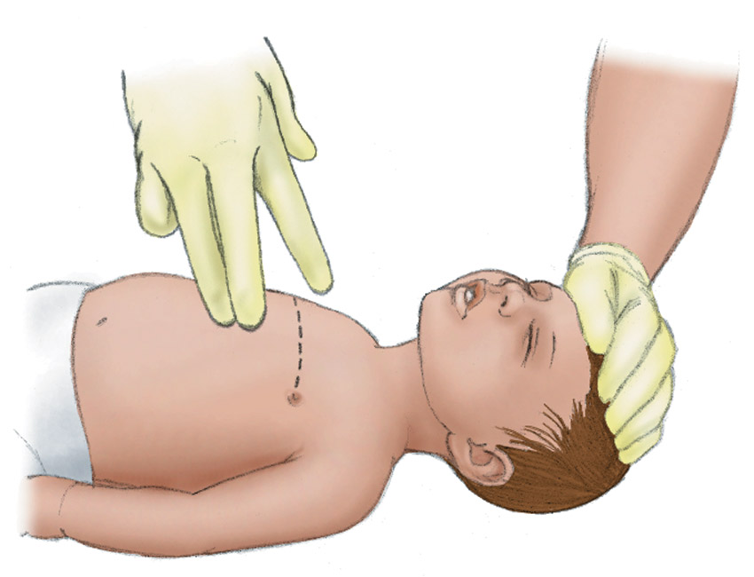
Performing Infant Chest Compressions
Position the infant on a firm surface while maintaining the airway. Place two fingers in the middle of the sternum just below a line between the nipples.
Use two fingers to compress the chest one third to one half its depth at a rate of at least 100 per minute. Allow the sternum to return to its normal position between compressions.

Slide 15
Physiology of Compressions
Cardiac Pump Mechanism
Thoracic Pump Mechanism
Blood is ejected as a direct result of compression of heart between sternum and vertebral column.
Increasing intrathoracic pressure develops a peripheral arteriovenous pressure difference that permits blood to flow forward in extrathoracic vascular system.

Slide 16
AIRWAY
After initiation of chest compressions, airway is evaluated and patency is established by a number of different maneuvers.

Slide 17
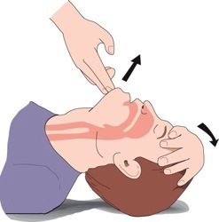
Head Tilt-Chin Lift
Place one hand on the victim’s hairline and place other hand’s index and middle finger on the chin and apply firm backward pressure.

Slide 18
This maneuver causes anterior displacement of the tongue

Slide 19
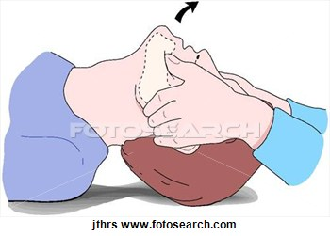
Jaw Thrust Maneuver
In Spine Injury
Accomplished by placing one hand on each side of victim’s head, grasping the angles of victim’s lower jaw lifting with both hands.

Slide 20
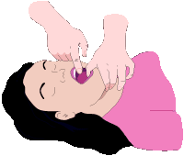
Finger Sweep Method
Foreign body is removed by finger sweep method

Slide 21
Heimlich Maneuver
Put your arms around the person and grasp your fist with other hand just below the center of rib cage.
Make a fist with one hand.
Lean the person slightly forward and stand behind him or her.
Make a quick, hard movement inward and upward.

Slide 22
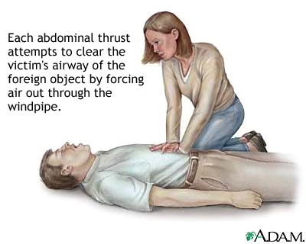
Heimlich Maneuver
Can also be done in lying down position.

Slide 23
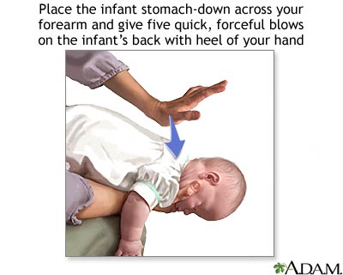
Heimlich Maneuver
In infants this can be done by a series of blows on the back and chest thrusts.

Slide 24
Advanced techniques for airway
Facemask
Oro pharyngeal airway
Nasopharyngeal airway
Laryngeal mask
Endotracheal tube
Tracheostomy

Slide 25
Endotracheal Intubation
Indications:-
The inability of the provider to ventilate the unconscious patient adequately with a bag and mask .
The absence of airway protective reflexes (coma or cardiac arrest).
The provider must have appropriate training and experience in endotracheal intubation.

Slide 26
Verify the tube position
Clinical assessment:-
Visualizing chest expansion bilaterally
Listening over the epigastrium (breath sounds should not be heard)
Listening over the lung fields bilaterally (breath sounds should be equal and adequate)

Slide 27
Devices:-
Exhaled CO₂ Detectors
Detection of exhaled CO₂ is one of several independent methods of confirming endotracheal tube position.
100% sensitivity and 100% specificity in identifying correct endotracheal tube placement.
Recommended as the most reliable method of confirming and monitoring correct placement of an endotracheal tube.

Slide 28
AUTOMATED EXTERNAL DEFIBRILLATOR (AED)
When using AED, one electrode pad is placed beside the upper right sternal border, just below the clavicle and the other electrode pad is placed just lateral to left nipple with top of the pad a few inches below axilla.
Alternative positions: anterior-posterior, anterior-left infrascapular, anterior-right infra scapular.

Slide 29
AUTOMATED EXTERNAL DEFIBRILLATOR (AED)
A single shock followed by immediate resumption of chest compression is recommended.
Shock energy:
Biphasic: 200 joules or specified by the manufacturer
Monophasic : 360 joules
There is no evidence that increasing the energy level in successive shocks is more effective than maintaining the energy level of the initial shock.

Slide 30
Drug Administration
Sites of Drug Administration
Peripheral
Preferred site as cannulation does not hinder CPR.
Drugs are given as bolus followed by 20 ml of intravenous fluid and extremity elevated for 10 to 20 seconds.
Intraosseous
Drug is delivered by puncturing the marrow cavity (usually in the sternum)
Endotracheal
Atropine, Epinephrine, Vasopressin and Lidocaine can be given.
Dose should be 2 to 2.5 times the recommended intravenous dose
All drug should be diluted into 10 ml of water or isotonic saline.

Slide 31
Vasopressor Drugs
Epinephrine
It is a b receptor agonist in low doses and an a receptor agonist in high doses.
Dose: 1 mg every 3-5 minutes in adults.
Can be given endotracheally.
Vasopressin
It is a non adrenergic vasoconstrictor that acts by direct stimulation of smooth muscle vasopressin 1 receptors leading to intense vasoconstriction of vasculature of skin, skeletal muscles, intestines and fat.
It also selectively vasodilates cerebral, coronary and pulmonary vascular beds.
Half life of 10-20 minutes
Dose: 40 units bolus intravenously. To replace 1st or 2nd dose of epinephrine
It increases myocardial oxygen consumption by increasing heart rate and afterload.
Beneficial during cardiac arrest mainly because of it’s a receptor properties

Slide 32
Anti Arrhythmic Drugs
Amiodarone
Prolongs repolarization and refractoriness in the sino-atrial node, atrial and myocardium, AV node and His-Purkinje cardiac conduction system.
Dose: 300 mg IV rapid infusion diluted in 20-30 ml of saline followed by second dose of 150 mg if needed.
Lidocaine
VT that has not responded to defibrillation.
May be considered if amiodarone is not available.
Dose: 1-1.5 mg/kg initial dose followed by 0.5 to 0.75 mg/kg every 5 to 10 minutes if needed. Maximum of 3 doses or 3mg/kg.
Magnesium
Effective in terminating polymorphic VT or torsades de pointes.
Dose: 1-2 gm infused over 5 minutes.

Slide 33
Drugs not recommended
Atropine
Not included as a drug for PEA, Asystole in the new CPR-ECC guidelines.
Sodium bicarbonate
Create extracellular alkalosis and inhibit oxygen release
Calcium
Routine administration of calcium for treatment of in-hospital and out-of-hospital cardiac arrest is not recommended
Use is retained for symptomatic bradycardia.
Dose: 0.5 mg IV every 3-5 min to a maximum of 3mg
May produce hypernatremia and hyperosmolarity
produces excess CO₂, which freely diffuses into myocardial and cerebral cells and may paradoxically contribute to intracellular acidosis.

Slide 34
Reversible causes
5 Hs | 5 Ts
Hypovolemia | Toxins
Hypoxia | Tamponade
Hydrogen ion( acidosis) | Tension pneumothorax
Hypo/hyperkalemia | Thrombosis(pulmonary)
Hypothermia | Thrombosis(coronary)

Slide 35
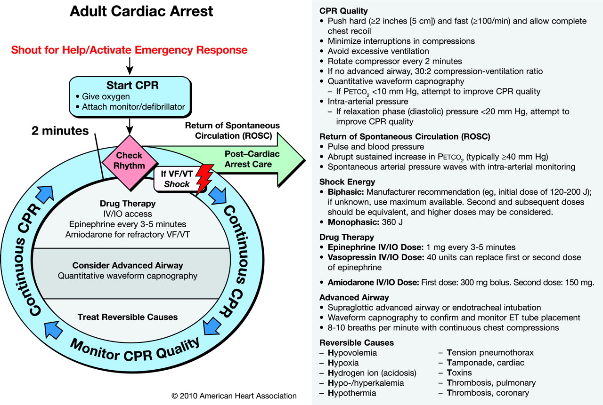
ACLS Cardiac Arrest Circular Algorithm.
Neumar R W et al. Circulation. 2010;122:S729-S767
Copyright © American Heart Association, Inc. All rights reserved.
Notes:
ACLS Cardiac Arrest Circular Algorithm.

Slide 36
Differences in Pediatric and Adult Resuscitation
 | Infant (1-12 months) | Child (>12 months) | Adult
Breathing Rate | 20 breaths per minute |  | 8-10 breaths per minute
Pulse Check | Brachial | Carotid | Carotid
Compression Rate | >100 per minute | 100 per minute | 100 per minute
Compression Method | 2 finger chest compression | Heel of one hand | Heel of both hands
Compression Depth | At least 1/3rd AP diameter; about 1.5 inches (4 cm) | At least 1/3rd of AP diameter; about 2 inches (5 cm) | At least 2 inches (5 cm)
Compression: Ventilation Ratio | 30:2 (Single rescuer) 15:2 (Two rescuers) |  | 30:2 (One or more rescuers)
Foreign Body Obstruction | Back blows and chest thrust | Heimlich manoeuvre | Heimlich manoeuvre

Slide 37
Modification in CPR in Pregnant Females
Position: Patient is put in left lateral position
Chest compressions are done slightly above the centre of the sternum
Insert an advanced airway early in resuscitation to reduce the risk of regurgitation and aspiration
Rapid sequence intubation with continuous cricoid pressure is the preferred technique for intubation
Decide whether to perform emergency hysterotomy
No modification in defibrillation

Slide 38
Changes in the new guidelines
The Change From "A-B-C" to "C-A-B“
Multiple valid reasons
By changing the sequence to C-A-B, chest compressions will be initiated sooner and ventilation only minimally delayed until completion of the first cycle of chest compressions (30 compressions should be accomplished in about 18 seconds).

Slide 39
The highest survival rates from cardiac arrest are reported among patients with a rhythm of VF or ventricular tachycardia (VT). In these patients the critical initial elements of CPR are chest compressions and early defibrillation.

Slide 40
Removal of “ look - listen – feel’’
Performance of these steps is inconsistent and time consuming.
For this reason the revised guidelines stress immediate activation of the emergency response system and starting chest compressions for any unresponsive adult victim with no breathing or no normal breathing (ie, only gasps).

Slide 41
Chest compressions
Emphasis on higher "chest compression rates”.
The recommendation has been changed from compression rate of "approximately 100/min" to compression rate of "at least 100/min".
The number of chest compressions delivered per minute during CPR is an important determinant of return of spontaneous circulation (ROSC) and survival with good neurologic function.

Slide 42
The recommendation for chest compression depth has also been changed to "at least 2 inches (5cm)".
Rescuers often do not push the chest hard enough. Studies have shown that increasing the depth of compressions is associated with increased blood flow.

Slide 43
Cricoid Pressure
Prevents gastric inflation and reduce the risk of regurgitation and aspiration during bag mask ventilation, but it may also impede ventilation.
Seven randomized studies showed that cricoid pressure can delay or prevent the placement of an advanced airway (e.g., endotracheal tube) and some aspiration can still occur despite application of cricoid pressure.
In addition, it is difficult to appropriately train rescuers in use of the maneuver.

Slide 44
New "circular" ACLS algorithm
The older 2005 "box and arrow" designed algorithm listed key actions performed during the resuscitation in a sequential fashion.
The revised algorithm is simplified and streamlined, and is "circular".
Before 2005, ACLS courses focused mainly on added interventions, such as manual defibrillation, drug therapy, and advanced airway management, as well as alternative and management options for special situations.
In ACLS 2010, the emphasis is exclusively on high quality CPR - the only thing which has consistently shown to work and improve outcomes.

Slide 45
Capnography
2005 guidelines only recommended CO2 detector device to confirm endotracheal tube placement.
Continuous quantitative waveform capnography is now recommended for intubated patients throughout the peri-arrest period.

Slide 46
Atropine is 'out'; Adenosine is 'in'
Atropine is no longer recommended for routine use in the management of pulseless electrical activity (PEA) and asystole.
Evidence suggests that the routine use of atropine during PEA or asystole is unlikely to have a therapeutic benefit .
Adenosine is recommended in the initial diagnosis and treatment of stable, undifferentiated regular, monomorphic wide-complex tachycardia.

Slide 47
Post-cardiac arrest care
Post-Cardiac Arrest Care is a new section in the revised guidelines.
To improve survival a comprehensive, multidisciplinary system of post-cardiac arrest care should be implemented in a consistent manner.
Treatments should include cardiopulmonary and neurologic support, as well as therapeutic hypothermia and percutaneous coronary interventions (PCIs), when indicated.

Slide 48
An electroencephalogram (EEG) for the diagnosis of seizures should be performed with prompt interpretation as soon as possible and should be monitored frequently or continuously in comatose patients after return of spontaneous circulation (ROSC).
The benefits of therapeutic hypothermia have been reemphasized, based on two recent large studies.

Slide 49
Alternative techniques and devices
Compared with conventional CPR, these techniques and devices typically require more personnel, training, and equipment, or they apply to a specific setting.
Rescuers should be trained to minimize any interruption of chest compressions or defibrillation and should be retrained as needed.

Slide 50
Techniques
1) High-Frequency Chest Compressions
High-frequency chest compression (typically at a frequency >120 per minute) has been studied as a technique for improving resuscitation from cardiac arrest and have demonstrated mixed results.
The 2010 AHA Guidelines for CPR and ECC recommend compressions at a rate of at least 100/min.
However, high-frequency chest compressions may be considered by adequately trained rescue personnel as an alternative (Class IIb, LOE C).

Slide 51
3)Interposed Abdominal Compression-CPR
3-rescuer technique
An abdominal compressor plus the chest compressor and the rescuer providing ventilations
Includes conventional chest compressions combined with alternating abdominal compressions.
The dedicated rescuer who provides manual abdominal compressions will compress the abdomen midway between the xiphoid and the umbilicus during the relaxation phase of chest compression.

Slide 52
IAC-CPR increases diastolic aortic pressure and venous return, resulting in improved coronary perfusion pressure and blood flow to other vital organs.
IAC-CPR may be considered during in-hospital resuscitation when sufficient personnel trained in its use are available (Class IIb, LOE B).

Slide 53
“Cough” CPR
The use of forceful voluntary coughs every 1 to 3 seconds shortly after the onset of a witnessed non perfusing cardiac rhythm in a controlled environment such as the cardiac catheterization laboratory.
Can generate systemic blood pressures higher than those usually generated by conventional chest compressions, allowing patients to maintain consciousness for a brief arrhythmic interval.

Slide 54
“Cough” CPR may be considered in settings such as the cardiac catheterization laboratory for conscious, supine, and monitored patients if the patient can be instructed and coached to cough forcefully every 1 to 3 seconds during the initial seconds of an arrhythmic cardiac arrest. (Class IIb, LOE C).

Slide 55
Prone CPR
When the patient cannot be placed in the supine position, it may be reasonable for rescuers to provide CPR with the patient in the prone position, particularly in hospitalized patients with an advanced airway in place (Class IIb, LOE C)

Slide 56
Precordial Thump
New to the 2010 Guidelines and is based on the conclusions reached by the 2010 ILCOR evidence evaluation process
The precordial thump may be considered for patients with witnessed, monitored, unstable ventricular tachycardia including pulseless VT if a defibrillator is not immediately ready for use (Class IIb, LOE C), but it should not delay CPR and shock delivery.

Slide 57
Devices to Assist Ventilation
Automatic Transport Ventilators
The use of an ATV may provide ventilation and oxygenation similar to that possible with the use of a manual resuscitation bag, while allowing the Emergency Medical Services (EMS) team to perform other tasks (Class IIb, LOE C).
Disadvantages include the need for an oxygen source and a power source.

Slide 58
Devices to Support Circulation
Active Compression-Decompression CPR
Performed with a device that includes a suction cup to actively lift the anterior chest during decompression.
The application of external negative suction during the decompression phase of CPR creates negative intra thoracic pressure and thus potentially enhances venous return to the heart.
Meta-analysis of 10 studies involving both in-hospital arrest (826 patients) and out-of-hospital arrest (4162 patients) and several other controlled trials comparing ACD-CPR to conventional CPR showed no difference in ROSC or survival.

Slide 59
Impedance Threshold Device
The impedance threshold device (ITD) is a pressure-sensitive valve that is attached to an endotracheal tube, supraglottic airway, or face mask.
The ITD limits air entry into the lungs during the decompression phase of CPR, creating negative intrathoracic pressure and improving venous return to the heart and cardiac output during CPR.
It does so without impeding positive pressure ventilation or passive exhalation.

